Slide 1
Detail area where data is collected or needs to be collected
NBA & WNBA
The NBA is a basketball sporting organization with a female organ also known as the WNBA. NBA stands for (National Basketball League), WNBA stands for (Women’s National Basketball League).
In the NBA, cameras are used to capture and record the games. From these videos, at the back room, analysis are made on the players and their roles.
During training sessions to monitor playmakers and health conditions
On the court during game play.
Opponent plays and coaching styles for better defense

Slide 2
What makes/ could make the organization data driven ?
The NBA has grown beyond what it used to be, plays have upgraded, competition amongst the 30 teams are at a clash ground and no one plays to loose
Technology came with bright minds and computers making use of algorithms, and artificial intelligence. This made recognising playing style of some teams and players easy.
Coaches are very analytical hence the need for this data to be available, making the best plays possible.
Player tracking on and off the court stands as a factor making the NBA data driven.
Player scouting was a hassle before the introduction of analytics in the NBA.
Track physical health and optimize rest time for players against the next game and injury.
Ratings in the NBA are used by teams, scouts, journalist and the media to predict play and future prospects.
Success rate of 3 points and 2 points players shoot at the basket. With a view of the analysis made on several players, coaches are confident on who to set at the 3 point lines

Slide 3
Is there any way it can add value if they start collecting data in one or more areas. What are the things they should measure ?
The NBA keeps evolving and is presently doing fine in terms of data collection, analytics and metrics. This alone adds value to each player by;
Helping the coaches have a ready analysis of players who are fit for the present and next games
Helps the players adjust their playing style and become better in the face of their opponent
Ensures the team has a graphic view of their opponents before each game, and areas they need to defend viciously giving them a win
Every team should have a staffing data analytics team, to help bring more insight on better performance making their game fast
Metrics will help players improve their 2 to 3 points skills. This alone if mastered skillfully, will bring victory on the team

Slide 4
Tools
Mention the tools they should use for collection of data ( You can mention any tools you may be aware of )
Researching the data source, ethically ensure, designing right database, searching and filtering data, analyzing the data and generating reports. These and more, are the key approaches with regards data collection and visualization in the NBA
Python (Programming language)
MySQL (storing the data)
Pandas (A library to work with the data)
Chartify (to create reports)
For example; and analytics company (Second Spectrum) gathers and codes a vast range of granular data for all thirty NBA teams. Machine learning makes use of this 3D player and ball movement data to produce interactive visualizations. This development helps teams analyze their performances and achieve marginal gains on the court.

Slide 5
Measure
Detail out what metrics they should monitor and how the metrics will help them improve either their revenues or the Bottomline
The player evaluation metrics helps in the following;
Player assist percentage. Basketball is a team game and at times, some players make more assist leading to game victories than the points made in the game. Such plays keeps the team happy, player remains signed bringing more money to the game
Player Efficiency Rating. An NBA team without efficient players will be an easy catch for the hungry teams. With data analytics, players are shown their capabilities and trained to improve the in game and training efficiency.
Defensive plays and Rebounds. A good defense brings victory, trophy and more money to the teams and players. The better your defense is, the easier it is to get those rebounds. This makes the game exciting, keeps the fans happy and in support of the game, raising the leagues value

Slide 6
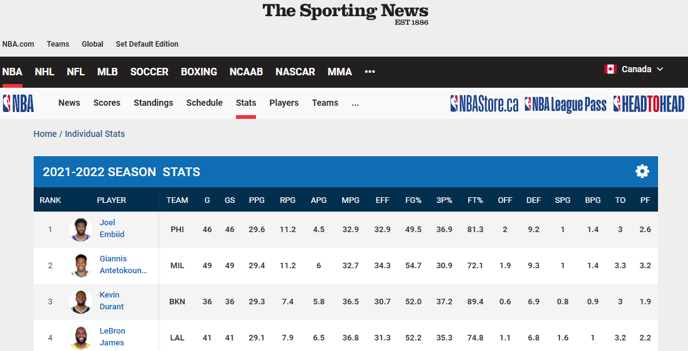

Slide 7

REFERENCES
How NBA Data Analytics is changing the sport. Dell Technologies. (2020, August 26). Retrieved February 24, 2022, from https://www.dell.com/en-us/perspectives/tech-takes-the-court-nba-teams-turn-to-data-and-analytics-for-a-competitive-edge/
NBA Stats. ca.global.nba.com. (n.d.). Retrieved February 24, 2022, from https://ca.global.nba.com/statistics/
Granular data. Stats Perform. (2019, October 16). Retrieved February 24, 2022, from https://www.statsperform.com/betting-fantasy/trading-tools/granulardata/

